Slide 1

Project One: Understanding Employee Turnover: A Data-Driven Perspective
Sydney Bailey
slbailey@mail.smu.edu

Slide 2
Agenda
Introduction
Data Analysis
Selection of components for modeling
Modeling results
KNN
Naïve Bayes
Cost implications
Conclusion

Slide 3


Understanding Employee Attrition Through Data
Frito-Lay partnered with Data Analytic Solutions to better understand and manage employee attrition.
Our objectives:
Identify the factors most related to attrition
Build models to predict employees at risk of leaving
Estimate the cost and savings impact of predictive interventions

Slide 4
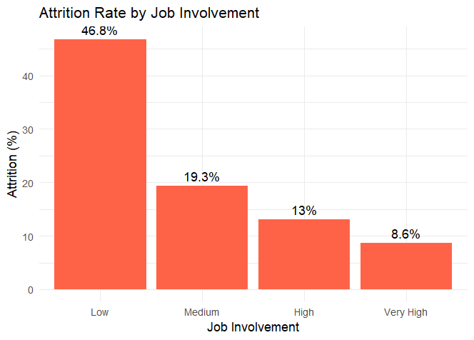
Job Involvement Strongly Affects Attrition
Chi-Squared | P-Value
41.465 | 5.211e-09
The relationship between job involvement and attrition is highly statistically significant.
Employees with different levels of job involvement show different likelihoods of staying or leaving the company.

Slide 5
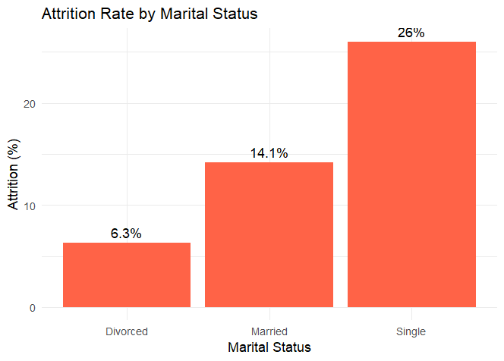
Attrition Significantly Differs by Marital Status
Chi-Squared | P-Value
39.406 | 3.379e-08
The difference in attrition by marital status is statistically significant (p < 0.05)
Single vs. married employees show notable differences in likelihood of leaving

Slide 6
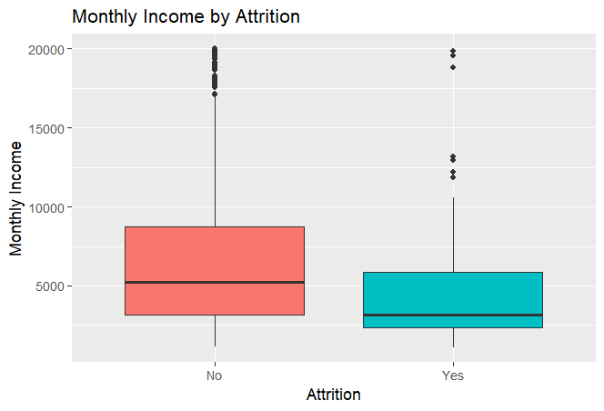
Lower Income Associated with Higher Attrition
T-Value | P-Value
5.3249 | 2.412e-07
Statistically significant (very low p-value) which indicates a clear relationship between pay and retention
Employees who left earned ~$1.2K–$2.6K less per month than those who stayed

Slide 7
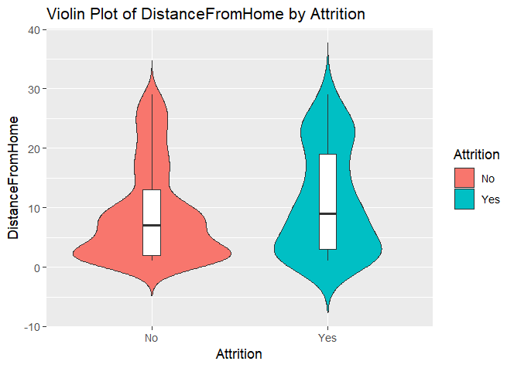
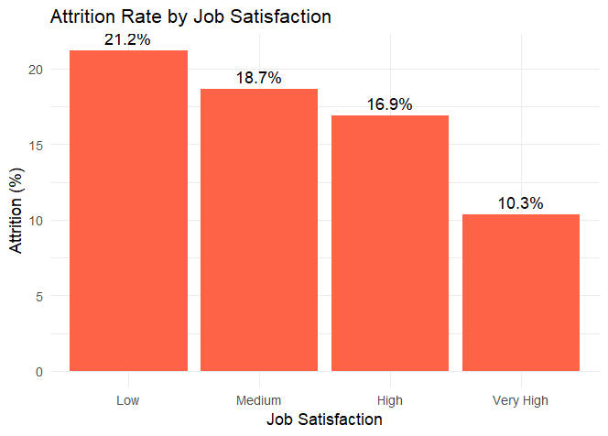
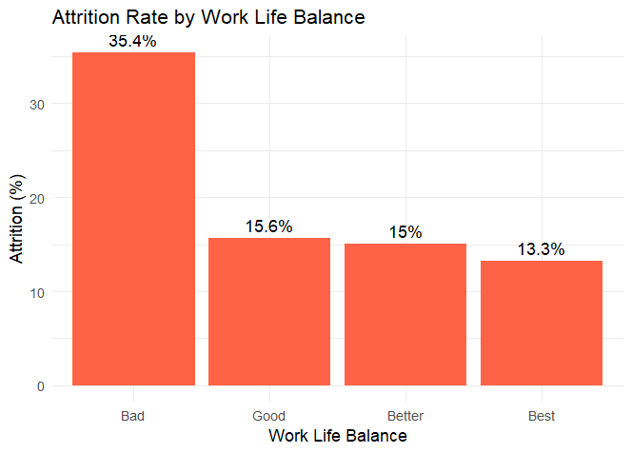
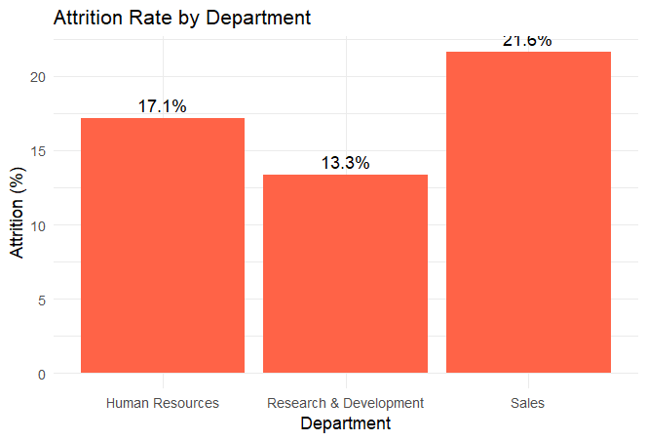
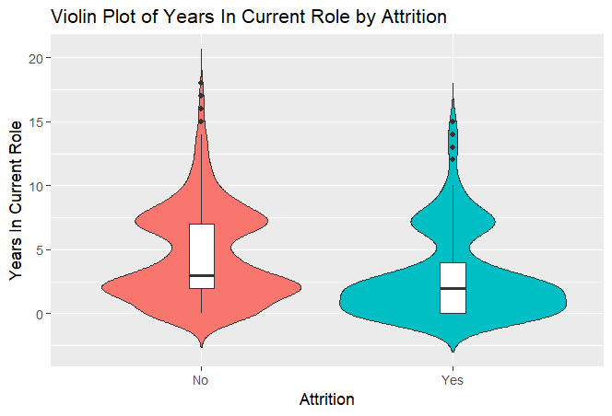
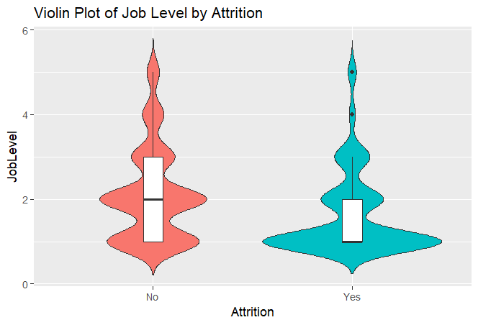
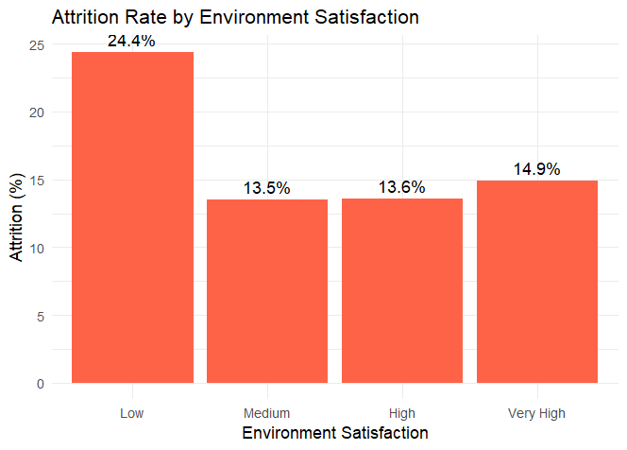
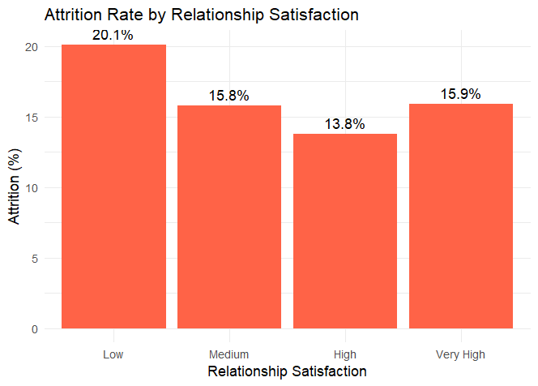
And many more

Slide 8
Spotting the Key Predictors of Attrition
Variable | P-Value | X-Squared | T-Value | Used in KNN? | Used in NB?
Job Involvement | 5.21E-09 | 41.465 |  | No | Yes
Marital Status | 3.38E-08 | 34.406 |  | No | Yes
Monthly Income | 2.41E-07 |  | 5.3249 | Yes | Yes
Job Level | 4.042E-07 |  | 5.231 | Yes | Yes
Years In Current Role | 1.52E-06 |  | 4.9513 | Yes | Yes
Years with Current Manager | 5.08E-06 |  | 4.6826 | Yes | No
Stock Option Level | 3.86E-05 |  | 4.216 | Yes | No
Work Life Balance | 0.002495 | 14.325 |  | No | No
Environment Satisfaction | 0.01054 | 11.231 |  | No | No
Job Satisfaction | 0.01115 | 11.109 |  | No | No
Distance From Home | 0.01641 |  | -2.4218 | Yes | No
Number of Companies Worked | 0.09788 |  | -1.6637 | Yes | No
Relationship Satisfaction | 0.3727 | 3.1253 |  | No | No

Slide 9
Evaluation of the K Nearest Neighbor (KNN) Model K = 5
Actual
 | No | Yes
No | 202 | 49
Yes | 7 | 3
Sensitivity: 3/52 = 5.77%
Predicted
Specificity: 202/209 = 96.65%
Sensitivity: It is estimated that this model will predict 5.77% of the those that will leave the company.
Specificity: It is estimated that this model will predict 96.65% of the those that will not leave the company.

Slide 10
Evaluation of the Naïve Bayes (NB) Model
Actual
 | No | Yes
No | 200 | 39
Yes | 9 | 13
Sensitivity: 13/52 = 25%
Predicted
Specificity: 200/209 = 95.69%
Sensitivity: It is estimated that this model will predict 25% of the those that will leave the company.
Specificity: It is estimated that this model will predict 95.69% of the those that will not leave the company.
Based on the data skew, we have found that we are really good at predicting who will not leave the company. We will need to do something to the data to be able to raise our sensitivity for those who will leave.

Slide 11
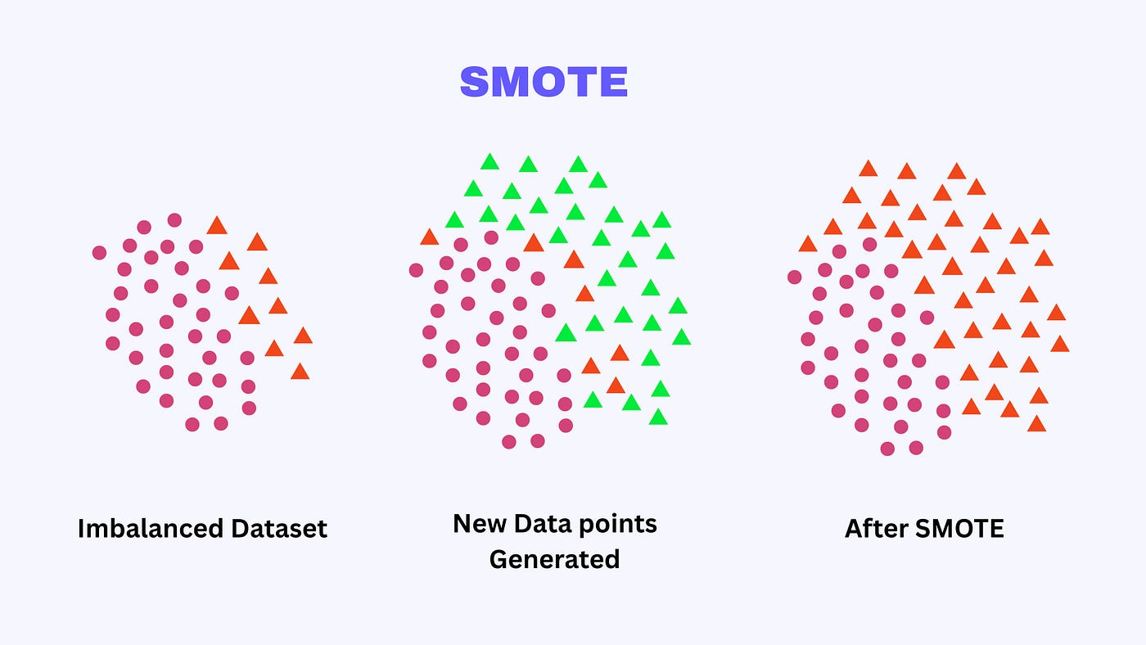
Synthetic Minority Over-sampling Technique Overview
SMOTE generates synthetic examples for the minority class to balance datasets.
Helps prevent model bias toward the majority class.
Applied here: 730 “stayed” vs. 140 “left” data points.

Slide 12
Evaluation of the K Nearest Neighbor Model K = 5 (smote)
 | Accuracy | Sensitivity | Specificity
Mean | 59.32% | 60.41% | 59.17%
Standard Deviation | 0.0028 | 0.0068 | 0.0034
Sensitivity: It is estimated that this model will predict 60.41% of the those that will leave the company.
Specificity: It is estimated that this model will predict 59.17% of the those that will not leave the company.
We are making improvements in our sensitivity with this model! Much better now that we were able to re-sample the data. We have improved from 5.8% to 60.41%

Slide 13
Evaluation of the Naïve Bayes Model (smote)
 | Accuracy | Sensitivity | Specificity
Mean | 63.51% | 69.75% | 62.36%
Standard Deviation | 0.0041 | 0.0071 | 0.0055
Sensitivity: It is estimated that this model will predict 69.75% of the those who are at risk of leaving the company.
Specificity: It is estimated that this model will predict 62.36% of the those that will not leave the company.
It may be argued that a greater sensitivity is more important than having a greater specificity in this problem because we want to be able to provide incentives for people who are at risk of leaving.
We are making improvements in our sensitivity with this model! Much better now that we were able to re-sample the data. We have improved from 25% to ~70%. We are really looking to have the highest sensitivity possible so that we can accurately predict who is at risk of leaving

Slide 14
Assumptions for Cost of Turnover Calculation
Job Level | Average Monthly salary | 9 Months of Salary | Average of the 9 month salary
Level 1 | $16,122.60 | $145,103.40 | $225,492.19
Level 2 | $20,355.47 | $183,199.23
Level 3 | $25,195.39 | $226,758.51
Level 4 | $29,938.60 | $269,447.40
Level 5 | $33,661.38 | $302,952.42
To keep employees from leaving we will offer a long-term incentive package of $10K. By accepting the long-term incentive package, the employee will commit to staying an additional 2 years. We believe doing this will reduce the total number of predicted people leaving by 31% (average percent of incentive programs)

Slide 15
Cost Evaluation of the KNN Model
Actual
 | No | Yes
No | 137 | 16
Yes | 83 | 25
Sensitivity: 25/41 = 60.98%
Predicted
Specificity: 137/220 = 62.27%
Sensitivity: It is estimated that this model will predict 60.98% of the those that will leave the company.
Specificity: It is estimated that this model will predict 62.27 of the those that are not at risk of leaving the company.
F1 score of ~34% tells us that we do not catch many of the people who leave and we predict many who leave who do not.
The cost associated with no intervention: 41 * $225K = $9,225K
The cost associated with intervention based on this model: 108 * $10K + (16 + 17) * $225K = $8,505K
Cost Savings: $720K

Slide 16
Cost Evaluation of the NB Model
Actual
 | No | Yes
No | 139 | 13
Yes | 75 | 34
Sensitivity: 34/47 = 72.34%
Predicted
Specificity: 139/214 = 64.95%
Sensitivity: It is estimated that this model will predict 72.34% of the those are at risk of leaving the company.
Specificity: It is estimated that this model will predict 64.95% of the those that are not at risk of leaving the company.
F1 score of ~43.6% tells us that we catch many of the people who may leave the company but there are many false positives that bring down the score.
The cost associated with no intervention: 47 * $225K = $10,575K
The cost associated with intervention based on this model: 109 * $10K + (13 + 23) * $225K = $9,190K
Cost Savings: $1,385K

Slide 17
From Data to Action: Retaining Our Talent
There were many significantly impactful statistics but there were 3 that were more significant than the rest
Job Involvement
Marital Status
Monthly Income
Younger, less experienced employees show a higher likelihood of leaving, while tenured and more integrated employees demonstrate greater retention.
Based on our analysis we will select the Naïve Bayes model for predicting attrition
Cost savings of $1,385K
Link to code:
Project One.RMD
Focus retention strategies on engagement, career development, and compensation equity for early-career employees.

Slide 18
Back Up

Slide 19
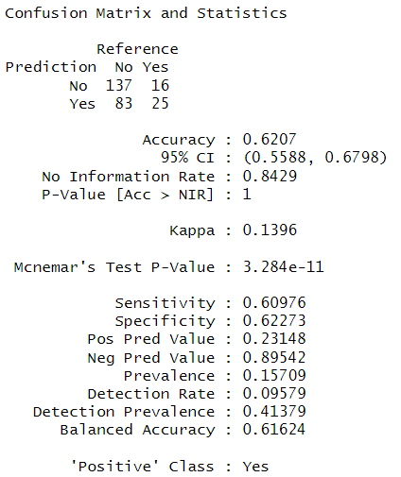
KNN model confusion matrix
As you can see, in our latest run we have the following statistics
Accuracy 62.07%
Sensitivity 60.98%
Specificity 62.27%

Slide 20
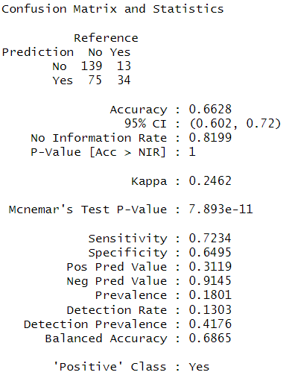
Naïve Bayes Confusion Matrix
As you can see, in our latest run we have the following statistics
Accuracy 66.28%
Sensitivity 72.34%
Specificity 64.95%

Slide 21
Running the Naïve Bayes on the test data
Predictions csv

Slide 22
Job Level Strongly Influences Attrition
T-Value | P-Value
5.231 | 4.042e-07
Highly statistically significant indicating employees who stayed had higher job levels than those who left
Lower-level employees were more likely to leave, while higher-ranking employees tended to stay

Slide 23
Time in Current Role Strongly Linked to Attrition
T-Value | P-Value
4.9513 | 1.522e-06
Statistically significant difference indicating employees who left had been in their current role for a shorter time than those who stayed
Suggests newer employees may be more likely to leave possibly due to dissatisfaction, poor fit, or unmet expectations

Slide 24
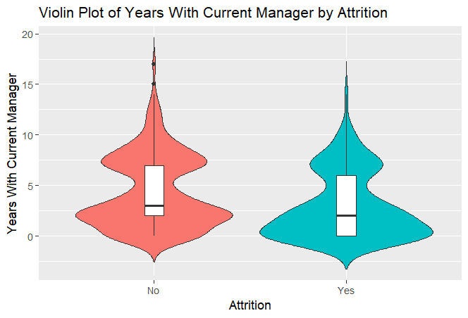
Shorter Manager Relationships Linked to Higher Attrition
T-Value | P-Value
4.6826 | 5.084e-06
Statistically significant difference meaning employees who left had spent less time with their current manager than those who stayed
Suggests shorter manager relationships may contribute to higher attrition — possibly due to less trust, mentorship, or support

Slide 25
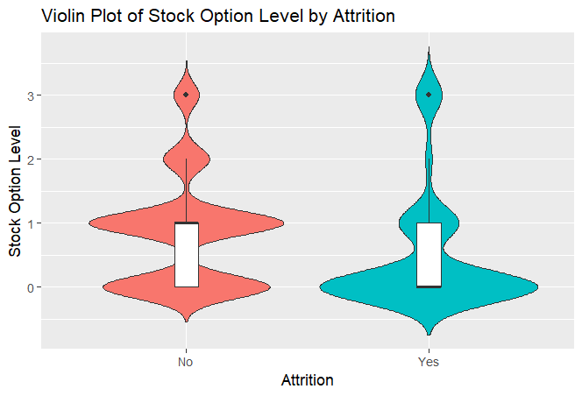
Stock Options Influence Employee Retention
T-Value | P-Value
4.216 | 3.86e-05
Employees who left had lower stock option levels on average.
Employees with fewer stock options were more likely to leave the company. Those with more stock options tended to stay.

Slide 26

Relationship Satisfaction
Based on the chi-squared test, relationship satisfaction scores do not appear to be significantly related to whether they left the company or not.

Slide 27

Environment Satisfaction
Employees' satisfaction with their work environment does appear to be related to whether or not they left the company. The distribution of environment satisfaction scores differs significantly between employees who stayed and those who left.

Slide 28

Work Life Balance
p = 0.002495 is statistically significant.
Employees with different levels of work-life balance have significantly different attrition rates. Poorer work-life balance may be linked to higher attrition.

Slide 29
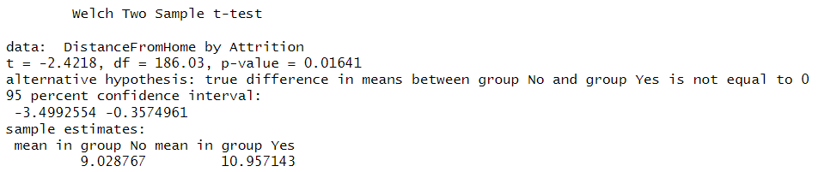
Distance From Home
There is a statistically significant difference in Distance From Home between employees who left and those who stayed. On average, those who left lived farther away from the workplace. This could suggest that commute distance might be related to attrition in your dataset.

Slide 30

Job Satisfaction
The p-value = 0.01115 is statistically significant.
Employees with different levels of job satisfaction are not equally likely to stay or leave the company. Those with lower satisfaction are likely contributing more to attrition.

